Slide 1
Prescribing Sleep

Slide 2
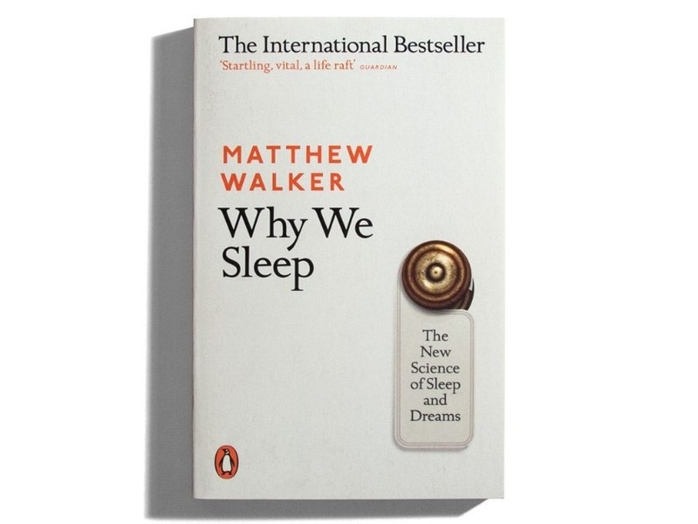

Slide 3
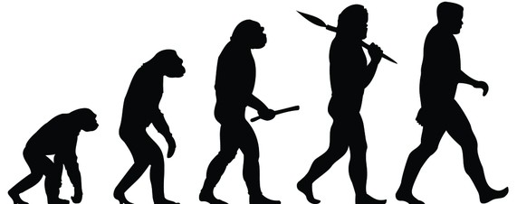
Sleep – Mother Nature’s Greatest Mistake?

Slide 4
Sleep – Mother Nature’s Greatest Mistake?
While asleep you cannot:
Gather food
Socialise
Mate and reproduce
Nurture and protect your offspring
Protect yourself
And yet every recorded species sleeps (or something very much like it)!

Slide 5
Owls & Larks Got Rhythm

Slide 6
Owls & Larks Got Rhythm
Approximate 24 hour sleep-wake rhythm
Larks (morning types) = 40% of population
Owls (evening types) = 30%
Others (somewhere between) = 30%
Owls struggle to go sleep early and find it hard to function in morning, society treats owls as if they were lazy but it is their genetic fate
Owl’s are punished by society, unable to get to sleep early but still having to wake at same time
Owls have a greater chance of developing depression, anxiety, diabetes, cancer, heart attack and stroke
There is a reason for different sleep patterns though (from evolutionary perspective) as this increases survival rate by 50% leaving us collectively vulnerable for 4 hours of the night rather than 8

Slide 7
Dancing To Our Own Tune

Slide 8
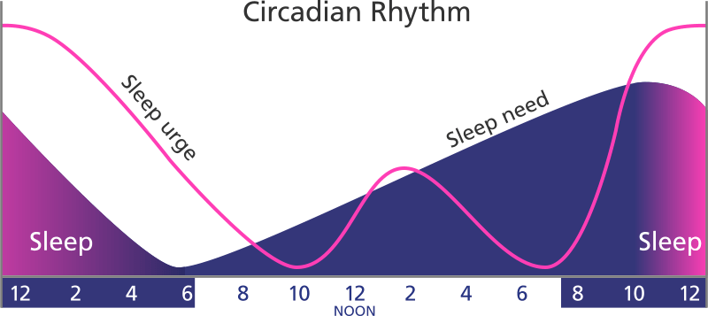
Dancing To Our Own Tune
Approximate 24 hour sleep-wake cycle runs by itself
First Experiment (1700’s)
However, it also latches onto repeating patterns
Daylight is the favoured repeating pattern and acts like manipulating fingers resetting an imprecise wristwatch
Food, temperature change, and even regularly timed social interactions / cues can all be used to modify the cycle

Slide 9
Dancing To Our Own Tune
Sleep pressure works in combination with the sleep cycle (but they are independent of each other)
The more the day goes on, the more the pressure builds to sleep
Sleeping in the afternoon reduces pressure and makes it more difficult to sleep at night
(more about sleep pressure)

Slide 10
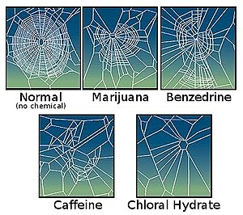
Dancing To Our Own Tune
Caffeine Facts
Caffeine Crash & Sleep Debt

Slide 11
Dancing To Our Own Tune
Impact of Changing Photoperiods

Slide 12
Dancing To Our Own Tune
Impact of Social Cues (XX)
23/01/2020 (03:11)
24/01/2020 (01:29)
25/01/2020 (02:57)
26/01/2020 (03:58)
27/01/2020 (00:10)
28/01/2020 (00:37)
29/01/2020 (00:25)
30/01/2020 (02:20)
31/01/2020 (23:46)
01/02/2020 (02:03)
02/02/2020 (00:43)
03/02/2020 (04:57)
04/02/2020 (00:46)
05/02/2020 (02:45)
06/02/2020 (00:26)
07/02/2020 (00:43)
08/02/2020 (00:27)
09/02/2020 (00:18)
10/02/2020 (00:21)
11/02/2020 (01:02)
12/02/2020 (00:34)
01/03/2020 (01:44)
02/03/2020 (23:28)
03/03/2020 (23:25)
04/03/2020 (23:32)
05/03/2020 (01:10)
06/03/2020 (01:15)
07/03/2020 (23:42)
08/03/2020 (22:35)
09/03/2020 (22:40)
10/03/2020 (23:18)
11/03/2020 (23:34)
12/03/2020 (23:34)
Social Cues Begin

Slide 13
Dancing To Our Own Tune

Slide 14
Dancing To Our Own Tune

Slide 15
Dancing To Our Own Tune

Slide 16
Dancing To Our Own Tune

Slide 17
Dancing To Our Own Tune

Slide 18
Dancing To Our Own Tune

Slide 19
Dancing To Our Own Tune

Slide 20
Dancing To Our Own Tune

Slide 21
Dancing To Our Own Tune

Slide 22
Dancing To Our Own Tune

Slide 23
Dancing To Our Own Tune

Slide 24
Dancing To Our Own Tune

Slide 25
Dancing To Our Own Tune

Slide 26
Dancing To Our Own Tune

Slide 27
Dancing To Our Own Tune

Slide 28
Dancing To Our Own Tune

Slide 29
Dancing To Our Own Tune

Slide 30
Dancing To Our Own Tune

Slide 31
Dancing To Our Own Tune

Slide 32
Dancing To Our Own Tune

Slide 33
Dancing To Our Own Tune

Slide 34
Dancing To Our Own Tune
Asleep
Awake

Slide 35
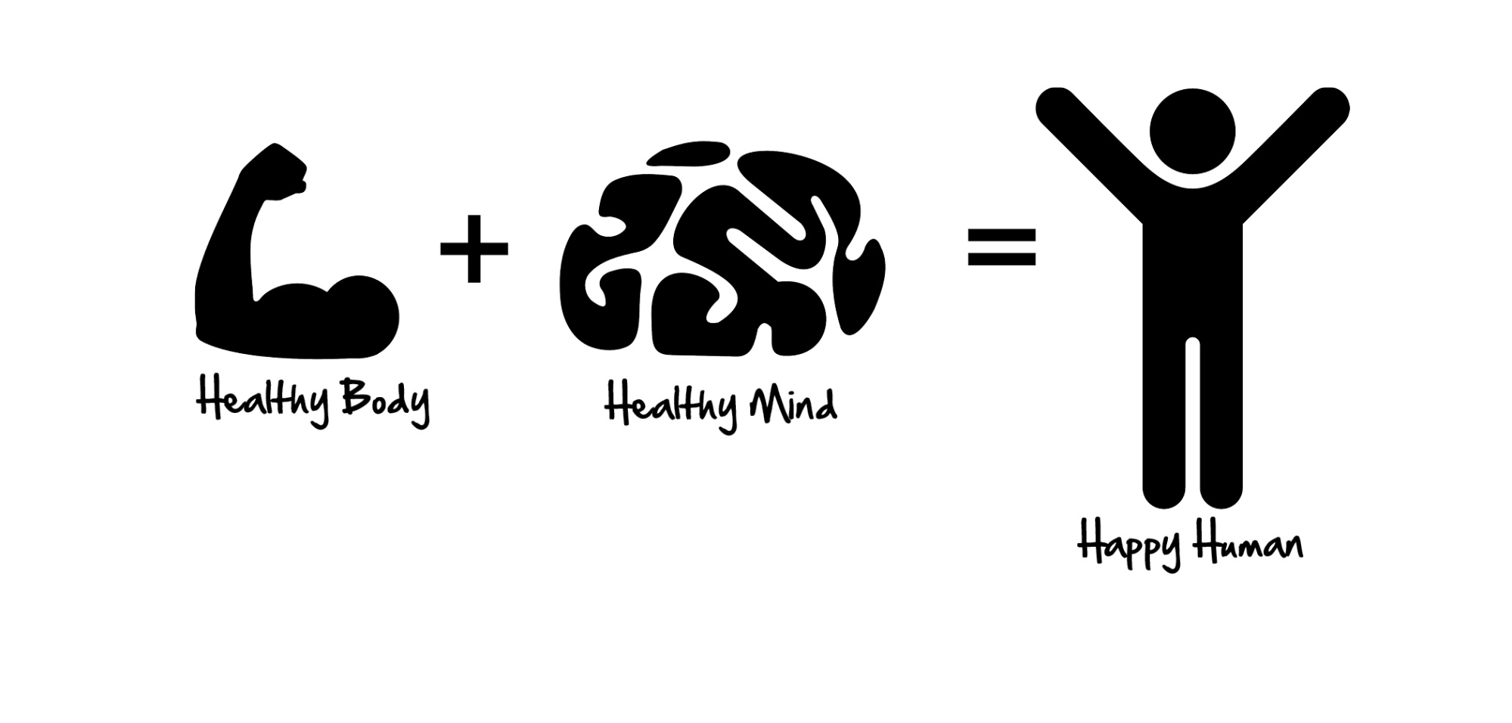
Sleep Better, Feel Better

Slide 36
Sleep Better, Feel Better
Every major organ in the body is enhanced by sleep (and detrimentally affected when we don’t sleep well)
It is the single most effective thing you can do to reset your brain and body health each day and should be considered as a ‘universal healthcare provider’
Sleep enhances our ability to learn, memorise and make logical decisions
It services our emotional circuits allowing us to better manage social and psychological challenges
It provides a consoling neurochemical bath that reduces the severity of painful memories
It provides a virtual reality space to meld together past and present experiences, inspiring creativity

Slide 37
Sleep Better, Feel Better
It also:
Boosts our immune system
Helps fight malignancy
Prevents infection
Fine tunes the balance of insulin and circulating glucose
Regulates appetite (controlling weight)
Aids nutritional health
Lowers blood pressure while keeping the heart in good condition

Slide 38
Waking Nightmare

Slide 39
Waking Nightmare
Two thirds of adults in industrialised nations fail to get recommended amount of sleep
Humans are the only species that will deliberately deprive themselves of sleep with no legitimate gain
WHO have declared a sleep loss epidemic through industrialised nations
People acclimatise to impaired performance, lower alertness and reduced energy levels – becoming the ‘norm’ or baseline

Slide 40
Waking Nightmare
Sleep loss inflicts devastating effects on the brain and is linked to numerous neurological and psychiatric conditions, there are no major psychiatric conditions where sleep is normal
The prevailing view in psychiatry has always been that conditions cause sleep disturbance but it’s actually a two way street – many of the brains regions commonly impacted on by psychiatric mood disorders are the same regions involved in sleep regulation and impacted on by sleep loss
Alzheimer's – sleep disturbance precedes onset by several years (early indicator), onset can be delayed by 5-10 years but sleep is not a magic bullet
Suicidal Ideation
PTSD
Depression
Bipolar Disorder
Stroke
Chronic Pain

Slide 41
Waking Nightmare
The part of our brain responsible for triggering strong emotions (accelerator) such as rage which is also linked with the flight or fight response can suffer from a 60% amplification in emotional reactivity where there poor sleep
The logical part of the brain (the brake) becomes uncoupled and so you end up with too much acceleration and not enough brake
Rather than being constant, this is more like a pendulum swinging back and forth between the extremes

Slide 42
Waking Nightmare
Sleep loss also impacts on the physiological system contributing to countless disorders and diseases
Cancer
Diabetes
Heart Failure
Weight gain / obesity
Immune deficiency
Overactive nervous system (flight or fight stuck in ‘on’ position), increases core temperature when we need to drop core temperature at night
Routinely having less than 6-7 hours per night demolishes the immune system and doubles the risk of cancer

Slide 43
Waking Nightmare
Having too little sleep swells concentrations of a hormone that makes you feel hungry
It also suppresses a companion hormone that signals food satisfaction (despite being full you want to eat more)
Attempting to diet without sleeping adequately won’t be effective as most of the weight you’ll lose will be lean body mass and not fat

Slide 44
Waking Nightmare
Other terrible truths:
In the US, one person dies every hour from a fatigue related road traffic accident, vastly exceeding those caused by alcohol and drugs (developed countries spend a mere 1% of their budget on informing public about dangers of drowsy driving)
Sleep disturbance is a hallmark of addictive substance abuse, relapse rates affected due to logical part of brain (the brake) being uncoupled
Sleep disruption almost always precedes the shift from stable to unstable manic depressive state in those with bipolar
Difficulty with sleep is highly prevalent in autistic individuals (40-80% prevalence in autistic individuals compared to 20-40% prevalence in neurotypicals)
Deprived of REM sleep, you cannot accurately decode facial expressions, you mistake friends for foes and the outside world becomes a more threatening place and you start making inappropriate decisions
Our nearest sleep clinic is 200 miles away, we do not have access to sleep specialists (apart from private specialists)

Slide 45
Sweet Dreams

Slide 46
Sweet Dreams
https://www.newdirectionsupport.com/improving-sleep-top-tips/
Stick to sleep schedule (set an alarm or another cue for bedtime)
Exercise but not too late in the day and definitely not 2-3 hours before bedtime
Avoid caffeine (takes as long as 8 hours to wear off) and nicotine (smokers sleep more lightly)
Avoid alcoholic drinks before bed (robs you of REM sleep)
Avoid large meals and beverages at night but you can snack (going to bed hungry will also cause disruption of sleep)
Avoid medicines that delay or disrupt sleep
Don’t take naps after 3pm
Relax before bed
Warm bath / shower before bed
Dark bedroom, cool bedroom, gadget free bedroom
Sunlight exposure in mornings and turn down lights before bed
CBT-I

